Slide 1
What Does It Cost to Save a Therm?
Presented by Steve Schiller, Sean Murphy,
Greg Leventis and Lisa Schwartz
Berkeley Lab Webinar – June 4, 2020
This work was supported by the U.S. Department of Energy’s Building Technologies Office.

Slide 2
Webinar Housekeeping Items
The report and webinar slides are posted here.
We’re recording the webinar and will post it on our web site.
Because of the large number of participants, everyone is in listen mode only.
Please use the Q&A box to send us your questions and comments any time during the webinar.
Moderated Q&A will follow our presentation. We’ll answer as many questions as we can at that time.
Notes:
We’re recording the webinar and will post it on our web site.
Because of the large number of participants, everyone is in listen mode only.
Please use the Q&A box to send us your questions and comments. You can enter your questions at any time. We’ll answer as many as we can, following the presentations.
I’ll then moderate Q&A with the authors.
The report and webinar slides are posted at the web site shown. Or search on cost of saving electricity at lbl.gov.
Following the webinar, we'll post a recording.

Slide 3
What is the Cost of Saving Energy and why is it important?
  Cost of Saving Energy (CSE) is:
    The cost of achieving energy savings over the estimated lifetime of the efficiency measures (programs) implemented
    Reported in dollars per unit of energy saved (e.g., $/therm)
      Program Administrator (PA) CSE accounts for expenditures for planning, administering, designing, implementing, and verifying programs as well as providing financial incentives to consumers (and others)
  Why it’s important
    State public utility commissions, utilities and other PAs use CSE data to:
      Assess energy savings potential and design
      Determine what programs to offer customers
      Implement programs in a cost-effective manner
      Accurately assess efficiency cost performance to ensure reliability most affordably
Notes:
What CSE is
Understanding the COSE NG is important for a number of reasons:
First, NG EE can help provide services at the most affordable cost
So understanding the cost of efficiency can help with integrated resource planning and with projecting efficiency’s impact on forecasts,
It can be used to screen NG EE as an alternative resource, and as a consideration for targeting markets, end-uses and measures,
As well as for evaluating how program costs are likely to change over time

Slide 4
Berkeley Lab Studies on Cost of Saving Energy
Program typology (2013)
First study on program administrator cost of saving energy (2014)
  For both natural gas and electric investor-owned utilities (IOUs)
  Cost to utility or third-party administrator (not including any participant contributions)
  Analysis down to program level
Updated analysis for electricity (2015), including total cost
  Total cost = PA cost + participant contributions
Most recent electricity analyses for IOUs
  116 PAs in 41 states, 2009-2015 (2018)
  Cost of saving peak demand, 9 states, 2014-2017 (2019) — expanded analysis underway
Analysis for publicly owned electric utilities with APPA (2019)
  111 PAs, representing 219 utilities in 14 states, 2012-2017
  Analysis at market-sector level
New study on cost of saving natural gas (2020)
https://emp.lbl.gov/projects/what-it-costs-save-energy
Notes:
Berkeley Lab has studied what it costs to save energy for the better part of the last decade.
We first produced a typology of efficiency programs based on market sector, technology, program design or delivery approach; then we began collecting and analyzing data from utility regulatory filings
Our analyses have largely focused on electricity at investor-owned utilities (e.g., our most recent report on saving a kWh came out in June 2018) but in the past few years we have expanded our focus to include
the cost of saving electricity during times of peak demand (we published a report on this last year covering 9 states and we are currently working on an expanded analysis)
The cost of saving electricity at publicly owned utilities, which we recently published a report on (also at the end of last year), that covers 219 utilities in 14 states
And following up on our previous analysis of the cost of saving NG, we have a new analysis on NG svgs that is in the process of being finalized for publication now. That’s the study I would like to tell you about today
---
We’ve conducted research on cost performance of efficiency programs for investor-owned utilities for nearly a decade. We published our most recent report on the cost of saving a kilowatt-hour in June 2018, spanning 116 utilities and other program administrators in 41 states through 2015. The work covers the cost to the program administrator, as well as the total cost, including participant costs. Analysis is at the program, market sector, regional and national levels.
We recently published a first-of-its-kind analysis of the cost of saving a kilowatt-hour during times of peak demand. This initial work spanned 9 states through 2017. We’re now expanding that analysis, so look for an update later this year.
Our new study on the cost of saving electricity for publicly owned utilities is at the market sector level — residential, commercial and industrial, low-income, and cross-cutting programs. It covers 111 program administrators representing 219 utilities in 14 states for the period 2012 to 2017. Some program administrators serve multiple utilities.
Altogether, our cost of saving electricity database has 13,000 program years of data, and it’s growing. You can see here the types of data we collect: annual savings, budgets & expenditures,
program type, average measure lifetimes and more.
We classify every program according to this typology. There are 65 detailed program categories consolidated into 27 simplified categories and then into market sectors. What you see here is just a sample.
Each program type is defined by market sector and technology, design or delivery approach.

Slide 5
Context
National average retail price of natural gas during our study period (2012-2017) was ~$1/therm¹
  Retail prices include the commodity cost as well as transportation, delivery and storage costs. Some jurisdictions also include avoided environmental costs and avoided gas price risks.
As another point of comparison, the average citygate (wholesale) price during this period was about $0.45/therm.²
U.S. households and businesses spent approximately $65 billion on utility-supplied natural gas in 2018.³
U.S. natural gas utilities spend about $1.3 billion a year on energy efficiency programs.⁴
¹ U.S. Energy Information Administration
² U.S. Energy Information Administration
³ American Gas Association
⁴ https://library.cee1.org/content/2018-cee-annual-industry-report/
Notes:
Thanks Lisa and hi everyone. Great to be able to have this opportunity to help present Berkeley Lab’s research on the program administrator’s cost of saving natural gas through energy efficiency.
Before Sean and Greg get into the results I am going to provide a bit of context for understanding and interpreting the results, letting you know about our data collection for this work and define what we man by levelized cost of saving gas
First some context - Like other aspects of life, questions come down to ‘as compared to what?’ So for the cost of saving natural gas, in a given jurisdiction it can be compared to the avoided costs for that jurisdiction.
Lets start with a consumer point of view, during our study period of 2012-2017 according to the Energy Information Administration (EIA), the National average retail price of gas during our study period was about a dollar a therm. And as you know, retail prices include the commodity cost as well as transportation, delivery and storage costs. Some jurisdictions also include avoided environmental costs and avoided gas price risks.
As another point of comparison, the average citygate price during this period was about $0.45/therm. Citygate prices are like a wholesale price for distribution utilities – citygate being A point or measuring station at which a distributing gas utility receives gas from a natural gas pipeline company or transmission system. So, the cost of natural gas to the distribution utility (such as citygate prices) are an approximate proxy for identifying what a utility would pay for natural gas versus paying for it not to be consumed (PA CSE). Of course that may not include other costs such as profits or environmental costs or distribution costs that eventually get one to a retail price. So that is some context on the dollar values we’ll be talking about on this webinar.
Now, some other context relates to – why does this matter. It matters as noted on this slide as reported by the American Gas Association - U.S. households and businesses spent approximately $65 billion on utility-supplied natural gas in 2018. And to address efficiency opportunities, U.S. natural gas utilities spend about $1.3 billion a year on energy efficiency programs. Thus, we spend a lot on natural gas in this country and a lot on trying to cost-effectively be efficient, and understanding what we are paying on a per unit basis for this efficiency is important, as Lisa pointed out, to determine the best options for investment in consuming or savings natural gas.

Slide 6
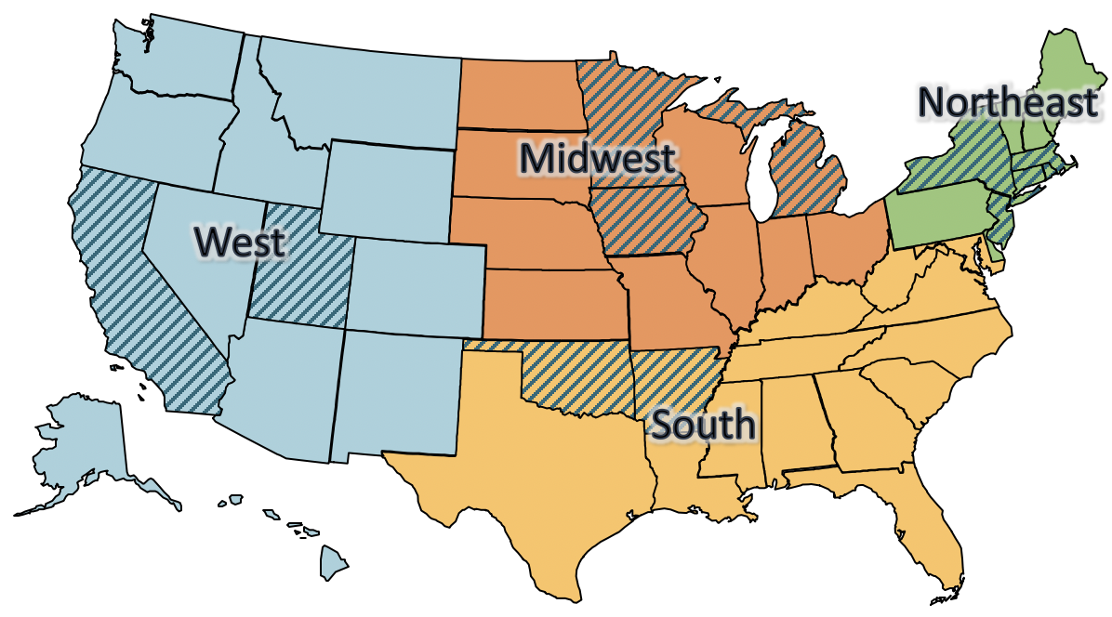
Study Scope
37 program administrators from 12 states: AR, CA, CT, IA, MA, MI, MN, NJ, NY, OK, RI and UT
  Account for ~50% to 70% of annual national spending on natural gas efficiency programs*
Representation in all four U.S. census regions
Portfolio and
market sector
spending
and savings
2012-2017
*Based on national spending on programs as reported by the Consortium for Energy Efficiency.
Notes:
In this new study, Berkeley Lab collected publicly available cost and savings data for 2012-2017 reported by IOUs and other program administrators (PAs) in a dozen representative states. The data analyses we were able to do with these data are at the sector level for the three core sectors for natural gas use: residential, low income, and commercial and industrial (C&I) - and at the portfolio level (which includes savings and costs for all sectors).
We prioritized data collection among states and PAs where our effort would go farthest in achieving objectives for data coverage, using the following criteria:
Geographic diversity – Data for at least two states with significant program spending in every U.S. Census region
Data publicly available – For all or most years from 2012 through 2017
Data already in hand – States and PAs where we had collected natural gas program data for these years as we updated our database for electricity analyses (particularly for dual-fuel utilities)
Share of national spending – Focus on states with a high share of national gas efficiency program spending
In the end we were able to gather data that represented national spending from about 50% to 70% (depending on the year) by year for the period 2012-2017, based on Consortium for Energy Efficiency (CEE) estimates of national gas efficiency program spending. We are thus able to calculate the cost of saving gas for 37 PAs in 12 states during this time period and at least 2 states with significant program spending from every U.S. census region are included. SO—although this is not an exhaustive look at all NG efficiency programs, it is a solidly representative sample of annual national and regional spending on NG EE programs
By the way, I want to also point out that this is the only initiative that has:
• Assembled data on a national scale for natural gas efficiency programs
• Maintained a long-running data series for detailed efficiency program spending and savings;
• Prioritized data obtained directly from regulatory filings by individual PAs (utilities and third-party administrators); and
• Employed a fairly rigorous data quality assurance/quality control (QAQC) regimen.

Slide 7
Definition: PA Cost of Saving Gas
Levelized Program Administrator Cost of Saving Gas (PA CSE) | The cost to the program administrator for achieving gas savings over the economic lifetime of the actions taken, discounted back to when the costs were paid and the actions occurred
Assumptions and inputs:
6% discount rate (real)
Estimated program average measure lifetimes
Total program cost (not including participant contributions), including incentives (2017$)
Gross annual therms saved
r = the discount rate
N = estimated program lifetime in years and calculated as the savings-weighted lifetime of measures or actions installed by participating customers in a program
Notes:
The metric we use to evaluate efficiency program costs is the Levelized Program Administrator Cost of Savings gas (PA CSE). And because this is important, I am actually going to read the definition on this slide: The cost to the program administrator for achieving gas savings over the economic lifetime of the actions taken, discounted back to when the costs were paid and the actions occurred.
This is the standard metric in the efficiency industry. And for history buffs, the levelized cost approach happens to be based on work back in 1982 at the Berkeley Lab led by Alan Meier.
This metric has 4 key assumptions and inputs. First, is the discount rate. Because we apply a discount rate to calculate levelized values, savings in later years have less impact on the program administrator cost of saving gas. Here, we use a discount rate of 6% based on utilities’ weighted cost of capital. If people have questions, we can talk about why we picked 6% for this study. Two points on this now though. We use a REAL discount rate because inflation already is accounted for in the use of constant dollars (2017$). And, of course, recall that lower discount rates reduce the CSE and vice versa.
Second, we use estimated average program measure lifetimes. As will be discussed later this is a potential area of potentially significant uncertainty.
Next we use the program administrator cost, which excludes participant costs but include incentives, administration, marketing, and evaluation costs.
Finally, the levelized cost calculation uses the gross annual energy savings, not accounting for net impacts such as what be estimates of free riders or spillover.
And a couple other quick points before we turn over to our next speaker to present the results –
The levelized costs we will present today are not for individual programs, they are aggregated at the market sector, region, or portfolio level. And, we use the savings-weighted average cost of saving gas for our studies, assigning the cost performance of each program administrator more or less value based on annual gas savings. That means programs with higher savings have greater influence on the average cost of saving gas than programs with lower savings.

Slide 8
Scale of Efficiency Investments in Our Sample
Our sample represents about $5B of spending and nearly 1.4B therms of energy savings during the study period: 2012-2017.
Sector | Annual Gross Savings (millions of therms) | Spending ($2017 million) | Average PA CSE ($2017) | Median PA CSE ($2017)
Residential | 587.3 | $2,283.7 | $0.43 | $0.40
C&I | 598.1 | $989.6 | $0.18 | $0.24
Low Income | 91.1 | $1,350.1 | $1.47 | $1.16
Portfolio (All Sectors) | 1,375.0 | $4,971.1 | $0.40 | $0.34
Notes:
These are national results incorporating all of the PAs we examined
Let me start by caveating that there is one category of spending not included in this table: cross-cutting (i.e., spending not associated with a single sector or which the PA only tracks on a portfolio-wide basis, such as research and development). That accounts for discrepancies in the sums and the portfolio totals (which do include the cross cutting sector)
Let me also say that these costs are highly sensitive to the discount rate and measure life assumed. For example, we assume a 6% discount rate but if we apply a 3 percent discount rate, the cost decreases from $0.40/therm to $0.33/therm.
Takeaway—Nearly $5B invested (from 2012-2017) and nearly 1.4B therms saved with a savings weighted average portfolio cost of saving NG of $0.40/therm over this period

Slide 9
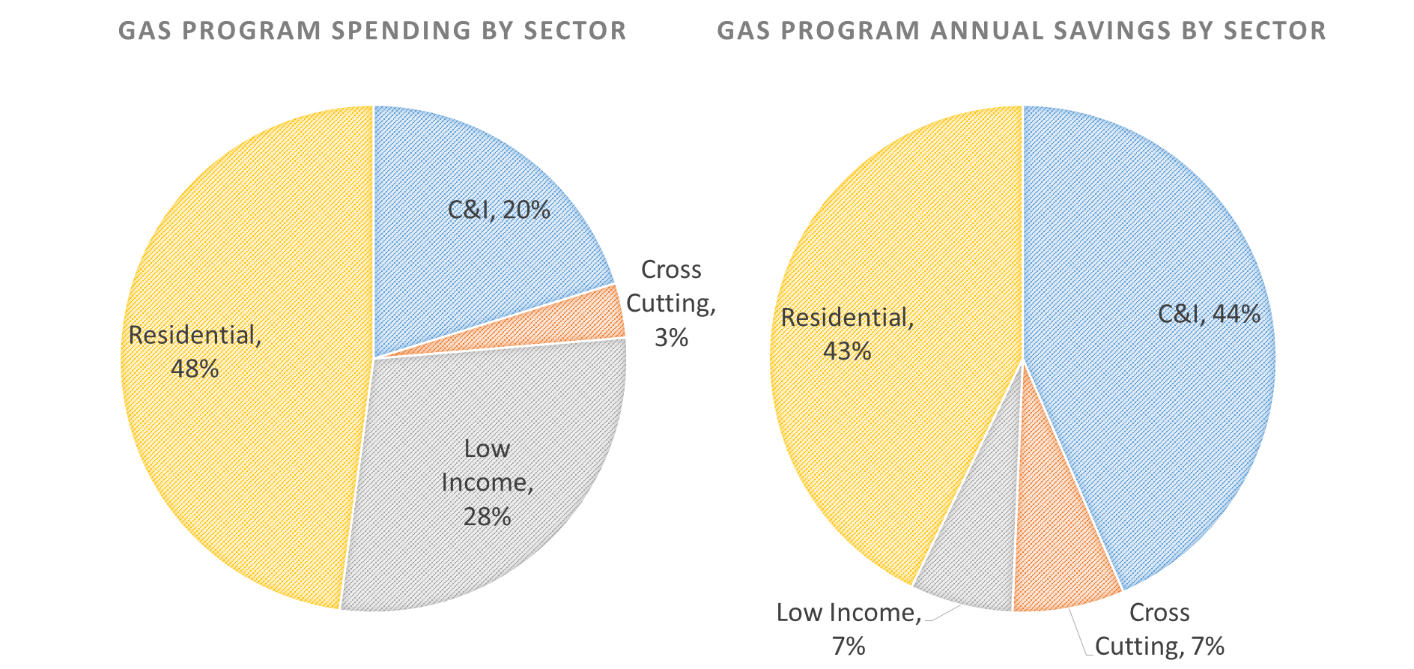
Spending and Savings by Sector
Residential and low-income sectors account for 48% and 28% of spending in our sample, respectively
Annual savings for residential and C&I are roughly equivalent
Notes:
These charts show relative shares of total spending and savings for our sample.
On the left is spending by sector and on the right is savings by sector.
Note that the share of spending for the resi and LI sectors is greater than their share of savings, and we will see that in their per therm cost of savings
Residential and low-income sectors account for 48% and 28% of spending in our sample, respectively.
Annual savings for residential and C&I are roughly equivalent.

Slide 10
Please use the Q&A box to send us your questions and comments any time during the webinar.
Moderated Q&A will follow our presentation. We’ll answer as many questions as we can at that time.

Slide 11
Results

Slide 12
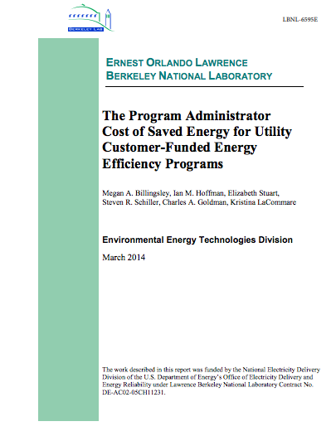
National Results
Savings-weighted average PA cost of saving gas is $0.40/therm for our 12-state sample over the 2012-2017 study period
Results are similar to a
2014 Berkeley Lab study,
which estimated savings at
$0.38/therm from 2009 to
2011
Notes:
Our top-line finding is that we estimate the cost of saving natural gas is 40 cents per therm for our 12-state sample during the 2012 to 2017 study period.
We expected the results for the new study to be higher than our 2014 study for several reasons, including the assumed impacts of inflation on efficiency program costs and the use of different base years (2017 versus 2012). The new study includes data from more utilities. Additional analysis is required to understand other factors that would explain why costs held relatively steady.

Slide 13
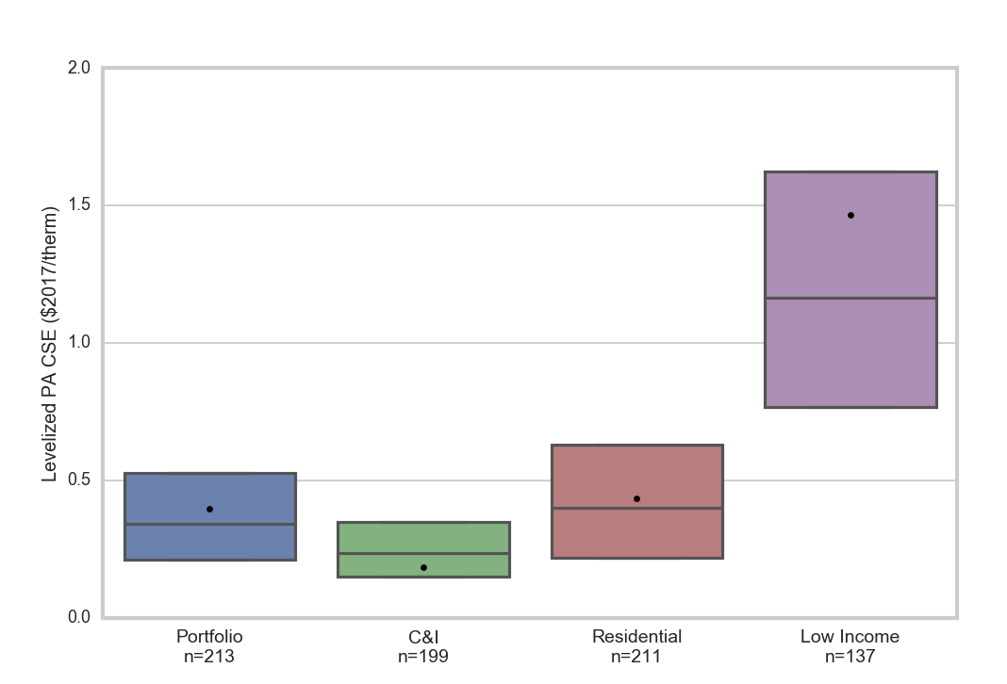
Cost by Market Sector
C&I programs provided savings at the lowest savings-weighted average cost ($0.18/therm). The cost of residential and low-income programs was $0.43/therm and $1.47 per therm, respectively.
  Residential and low-income programs represent ~¾ of spending in our dataset.
Savings-weighted averages (dots),
medians (horizontal lines) and
interquartile ranges (boxes)
Notes:
This graph breaks the findings into sectors (along the bottom, with costs per therm on the vertical axis). Each dot shows the savings-weighted average value, the lines indicate the median savings value (i.e., half of the programs had costs AT or below this value) and the box itself shows the middle interquartile range (which shows where the middle half of observations are).
The savings-weighted average gives an idea of what costs look like in the entire group of program administrators analyzed; the median provides a similar picture but gives the same weight to all program administrators regardless of the size of their programs; and the interquartile ranges offer an idea of the variability across program administrators.
An important note is that the cost of saving NG in your jurisdiction should not be compared to NG commodity prices alone but to avoided costs in your jurisdiction, which include the commodity costs but also transportation, delivery and storage costs. Some jurisdictions also include avoided environmental costs and reduced risk benefits.
Takeaways: Commercial programs tend to have lowest cost of savings and the least variability in cost.
And, as we have consistently found in other analyses, LI programs have much higher COSE—partly explained by 1) PAs pay 100% of costs, and 2) they may have other program goals beyond saving energy, like reduced energy bills and improved health for occupants
---
I want to first note that the sample sizes indicated here and in the next slide refer to ‘sector and portfolio years’ (e.g., under the ‘[Portfolio’ bar, n=213). A ‘sector or portfolio year’ is the cost for one program administrator for one year. So let’s say we have the portfolio costs from program administrator X for 2015and 2016, then we have 2 portfolio years.
Savings-weighted average cost per therm:
C&I - $0.18, residential - $0.43, low-income - $1.47

Slide 14
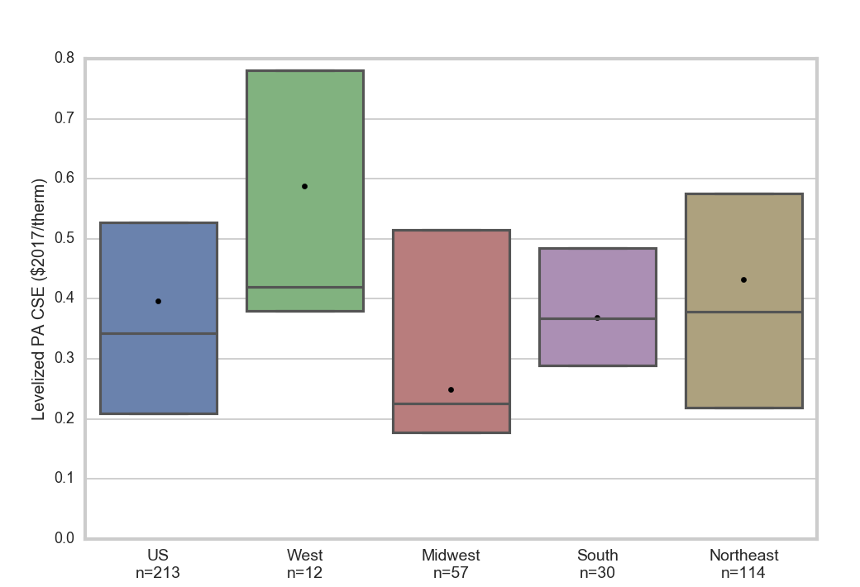
Costs by Region
Cost/therm varies by region—e.g., Midwest at $0.25 vs. West at $0.59
High spending on low-income programs in West likely drives some of this disparity; also, weather-driven differences in savings opportunities
Notes:
Here we show the cost of saving a therm by region. So these numbers are for each PA’s entire portfolio (i.e., all sectors).
You can see that costs vary significantly from region to region: the lowest in the Midwest (at $0.25/therm) to the highest in the West (at $0.59/therm).
Climate probably plays a role in the low MW costs, e.g., replacing a furnace in cold Midwest states could save more NG than doing so in more temperate states
So what we see here is that there’s a lot of variability in the cost of saving a therm across regions

Slide 15
Results by Sector and Region
Notes:
Building off what Greg shared on the trends across Regions and Sectors, this figure shows how levelized PA costs of gas efficiency vary by Region and Sector. This allows us to unpack regional differences from the sector numbers.
We can see that for Residential and C&I, the Midwest is the least cost region in each sector plot, followed by the South and then the Northeast and West together. When we look at Low Income, some significant differences emerge. The Midwest and Northeast are close together around $1/therm, the South at $.50/therm, but the West is much higher at $5/therm.
The Western costs are high due to limited sample sizes. We were only able to collect data on low income programs from two PAs in the West – Questar and SCG

Slide 16
Cost and Savings Trends
Average CSE values trended downward from 2012 to 2017
Annual achieved savings trended up, at higher rate than spending
Program administrator CSE
Lifetime savings
Annual efficiency spending
Annual energy savings
Notes:
Here is a summary of our analysis on time trends in the levelized program administrator cost of gas energy efficiency and the inputs into our levelized cost calculation.
We have two vertical axes on this figure. On the left side, we have units in millions of dollars, referring to the lifetime savings in orange, annual dollars spent in dark blue, and annual therms saved in light blue. The right vertical axis refers to the black line showing the cost of saving a therm.
Because we are looking at trends over time, we restrict this figure to just the 32 of 37 PAs in our study that provided continuous portfolio-level data over the 6 years of the study. The cost of saving a therm in this sample fell nearly 30% from $0.52/therm in 2012 to $0.37/therm in 2017. Annual and lifetime therm savings have increased more than 150% while annual spending has grown by nearly 90%.
The important point here is that the cost to save natural gas through utility efficiency programs decreased during the study period, and programs are providing more savings.

Slide 17
Challenges and Opportunities

Slide 18
Data and Reporting Challenges
Data quality and screening challenges — for example, program administrator definition, estimation and reporting of:
  Savings metrics
  Program costs
  Market sectors
  Program types
  Measure lives
Reporting of gas program data has improved in many states. But significant and meaningful opportunities remain for greater transparency, rigor and comprehensiveness in data reporting.
Notes:
In the course of this project, we confronted a number of challenges.
Program administrators have varying approaches to defining, estimating and reporting gas energy efficiency.
For example, with savings metrics we have seen varying definitions of net and gross savings, sometimes based on what adjustment factors are applied (realization rates, spillover, verification).
Program administrators also have different ways of classifying their programs. Berkeley Lab developed a typology for these programs that we use for consistent classification and aggregation into the sectors used in this analysis.
Measure lives are another challenge in the analysis of efficiency programs cost trends. Measures lives, be it for electric or gas measures, are difficult to estimate and would benefit from devoted measurement and verification. Often, we found reported lifetimes in increments of 5 years applied to programs across multiple years of data, despite likely changes in measure mix.
Now this has improved in many states but there are opportunities for further improvements.

Slide 19
Opportunities: Additional Research
This work could be strengthened and supplemented with the following additional research:
  Expand data collection to other states for fuller geographic representation, larger sample size and greater confidence in the results
  Provide technical guidance and support to states and PAs for more consistent reporting and improvements in evaluation, measurement, and verification and estimation of savings from natural gas efficiency programs
  Conduct analyses to identify the drivers of a downward trend in the average PA CSE from 2012 to 2017, as well as factors such as climate that drive differences in the cost of saving gas across states
  Analyze PA CSE for gas by efficiency program type (e.g., residential new construction, industrial process, commercial heating, ventilating and air-conditioning)
  Develop a cost curve for gas efficiency programs
  Assess the potential impact of PA size on cost
  Estimate the Total CSE for natural gas programs, including participant costs
Notes:
Finally, this work could be expanded:
Collecting data from more states and PAs to provide broader geographic representation, and increased sample size
Providing technical assisatnce on improved reporting and measurement and verification to improve the quality of reported information
Deeper analysis could be done on cost trends (e.g., trying to capture what’s driving the trends)
Larger sample size is very important here so that a single PA does not drive results
A program-level analysis would provide more granularity and insight into the trends we’ve presented here and would help identify drivers in low cost efficiency. We typically conduct program-level analysis for the cost of saving electricity.
For electric program administrators, we’ve developed a cost curve, plotting the cost of saving energy by program type against its share of portfolio lifetime savings. These curves help illustrate what efficiency resource is available at different costs and how programs contribute to large portfolios. We could also develop these curves for gas efficiency.
We could also explore potential economies of scale in efficiency, by comparing the cost of saving a therm to PA size
Finally, we could include participant costs in our analysis and study the total cost of natural gas efficiency.
We should note, however, that these research ideas are not funded projects, only areas we consider important for understanding the economics of utility ratepayer-funded gas efficiency programs.

Slide 20
Q&A
Please use the Q&A box to send us your questions and comments.

Slide 21

For More Information
https://emp.lbl.gov
Join our mailing list (https://emp.lbl.gov/mailing-list) and stay up to date on our publications, webinars and other events. Follow us on Twitter @BerkeleyLabEMP
Lisa Schwartz
lcschwartz@lbl.gov

